Slide 1
Object Oriented Programming Lab #07 In-Depth understanding the concept of Inheritance
ENGR SANIYA SARIM

Slide 2
Inheritance Introduction
The process by which one class acquires the properties(data members) and functionalities(methods) of another class is called inheritance.
The aim of inheritance is to provide the reusability of code so that a class has to write only the unique features and rest of the common properties and functionalities can be extended from the another class.

Slide 3
Child and Parent Classes
Child Class:
The class that extends the features of another class is known as child class, sub class or derived class.
Parent Class:
The class whose properties and functionalities are used(inherited) by another class is known as parent class, super class or Base class.

Slide 4
Advantages Of Inheritance
Inheritance is a process of defining a new class based on an existing class by extending its common data members and methods.
Inheritance allows us to reuse of code, it improves reusability in your java application.
Note: The biggest advantage of Inheritance is that the code that is already present in base class need not be rewritten in the child class.
This means that the data members(instance variables) and methods of the parent class can be used in the child class as.

Slide 5
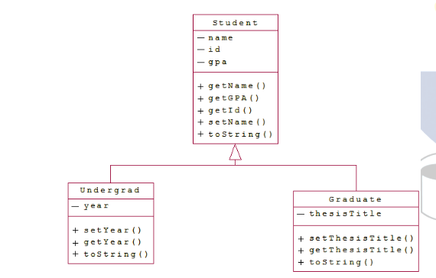
Inheritance

Slide 6
Inheritance
The class Student is the parent class. Note that all the variables are private and hence the child classes can only use them through accessor and mutator methods. Also note the use of overloaded constructors.

Slide 7

Syntax: Inheritance in Java
To inherit a class we use extends keyword. Here class XYZ is child class and class ABC is parent class. The class XYZ is inheriting the properties and methods of ABC class.

Slide 8
Inheritance Example
In this example, we have a base class Teacher and a sub class PhysicsTeacher. Since class PhysicsTeacher extends the designation and college properties and work() method from base class, we need not to declare these properties and method in sub class.
Here we have collegeName, designation and work() method which are common to all the teachers so we have declared them in the base class, this way the child classes like MathTeacher, MusicTeacher and PhysicsTeacher do not need to write this code and can be used directly from base class.

Slide 9
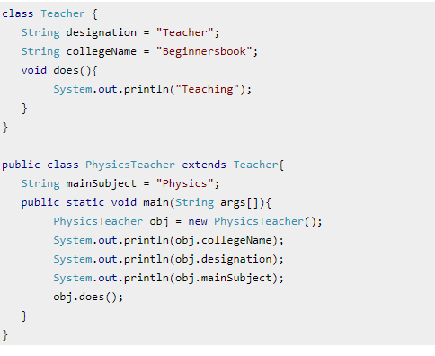
Example of Inheritance

Slide 10

Output
Based on the above example we can say that PhysicsTeacher IS-A Teacher. This means that a child class has IS-A relationship with the parent class. This is inheritance is known as IS-A relationship between child and parent class

Slide 11
How to access private members of Parent Class?
The derived class inherits all the members and methods that are declared as public or protected. If the members or methods of super class are declared as private then the derived class cannot use them directly. The private members can be accessed only in its own class. Such private members can only be accessed using public or protected getter and setter methods of super class as shown in the example below.

Slide 12
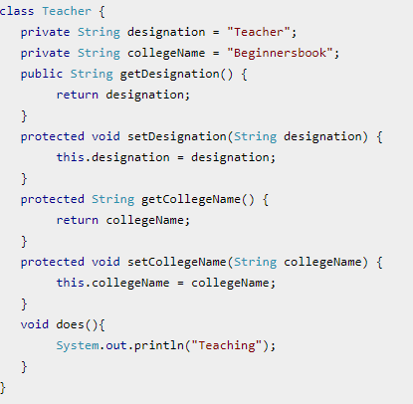
Example

Slide 13
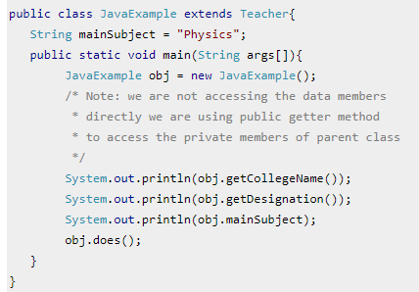
Example

Slide 14

Output
The important point to note in the above example is that the child class is able to access the private members of parent class through protected methods of parent class. When we make a instance variable(data member) or method protected, this means that they are accessible only in the class itself and in child class.

Slide 15
Exercise
Create a superclass vehicle that contains color, speed and size as commmon attributes to all subclasses, whereas a method name attributes() to display all the attributes of a vehicle.
Then create a subclass car that inherits the features of the base class vehicle and has its own unique attributes as gears and CC. It has a method name attributescar() that displays its attributes.
Using the inheritance concept display all attributes of car (child class) in main method.

Slide 16
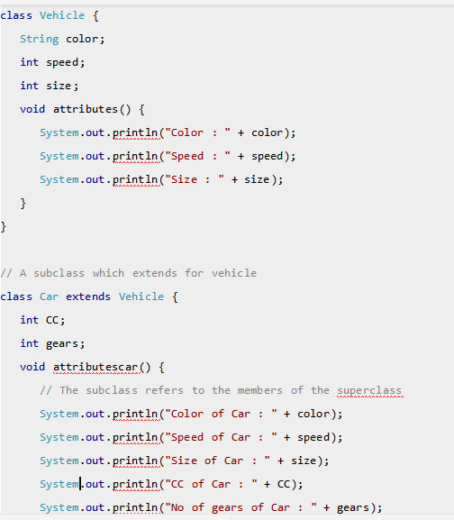
Example of Inheritance

Slide 17
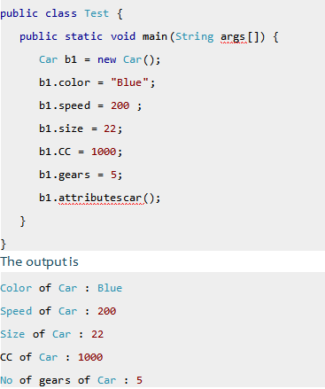
Main method and Output

Slide 18
Exercise
Now make the size and speed attribute of the superclass as private.Design accessor and mutator methods of size and speed so that the child class can access the private attributes of the parent class.

Slide 19
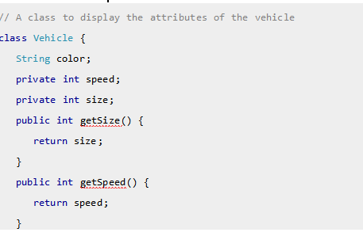
Accessor methods

Slide 20
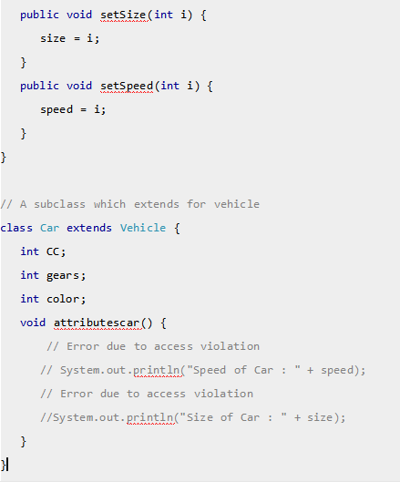
Mutator Methods

Slide 21
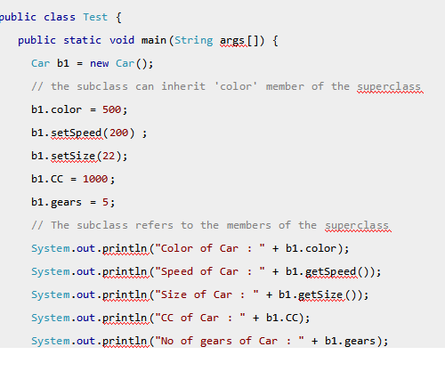
Main method

Slide 22
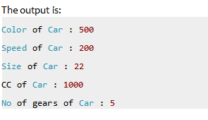
Output

Slide 23
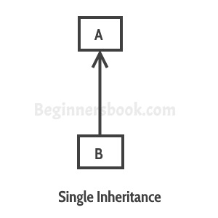
Types of inheritance
Single Inheritance: refers to a child and parent class relationship where a class extends the another class.

Slide 24
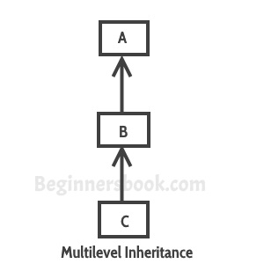
Types of Inheritace
Multilevel inheritance: refers to a child and parent class relationship where a class extends the child class. For example class C extends class B and class B extends class A.

Slide 25
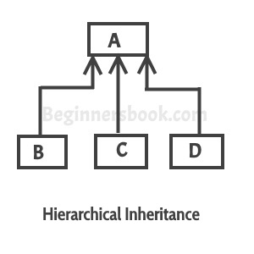
Types of Inheritance
Hierarchical inheritance: refers to a child and parent class relationship where more than one classes extends the same class. For example, classes B, C & D extends the same class A.

Slide 26
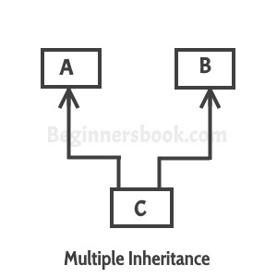
Types of Inheritance
Multiple Inheritance: refers to the concept of one class extending more than one classes, which means a child class has two parent classes. For example class C extends both classes A and B. Java doesn’t support multiple inheritance.

Slide 27
Types of Inheritance
Hybrid inheritance: Combination of more than one types of inheritance in a single program. For example class A & B extends class C and another class D extends class A then this is a hybrid inheritance example because it is a combination of single and hierarchical inheritance.

Slide 28
Constructors and Inheritance
constructor of sub class is invoked when we create the object of subclass, it by default invokes the default constructor of super class. Hence, in inheritance the objects are constructed top-down.
The superclass constructor can be called explicitly using the super keyword, but it should be first statement in a constructor. The super keyword refers to the superclass, immediately above of the calling class in the hierarchy.
The use of multiple super keywords to access an ancestor class other than the direct parent is not permitted.

Slide 29
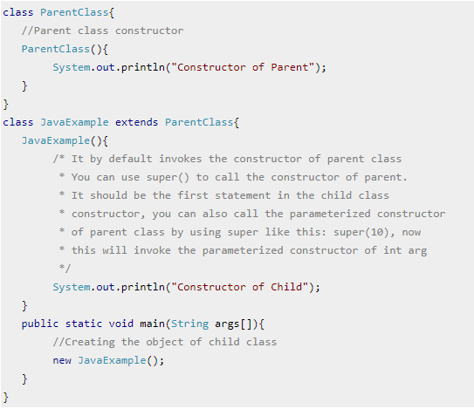
Example

Slide 30

Output

Slide 31
More Understanding
For more understanding of constructors in inheritance refer to the word document uploaded on my site containing the example.

Slide 32
Inheritance and Method Overriding
When we declare the same method in child class which is already present in the parent class the this is called method overriding. In this case when we call the method from child class object, the child class version of the method is called. However we can call the parent class method using super keyword as I have shown in the example below:

Slide 33
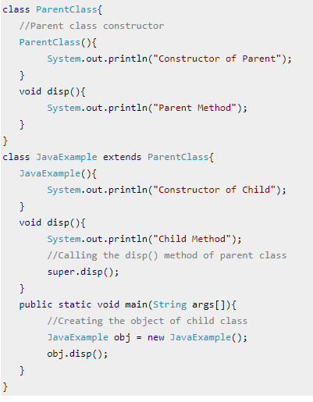
Example

Slide 34
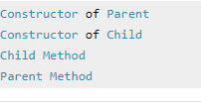
Output

